Slide 1
TAS152
LECTURE 13
TOPIC 2
ETHICS IN THE INFORMATION SOCIETY
2.6 PIRACY: INTELLECTUAL PROPERTY AND CYBERCRIME

Slide 2

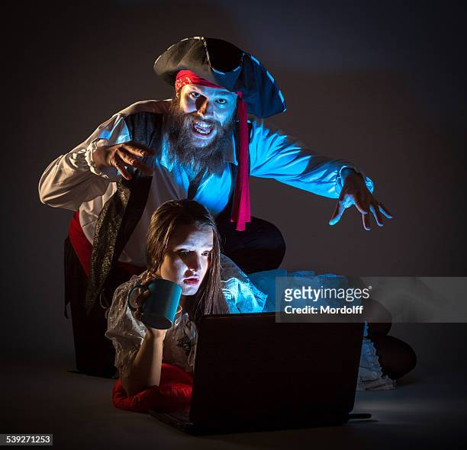

DIGITAL PIRACY
‘digital pirates’ steal information from the websites of governments, organisations and individuals, without the knowledge/consent of the owners of the information.
Digital (music and books) is frequently downloaded without permission or payment.
Pirating is often conducted with the use of torrent.

Slide 3
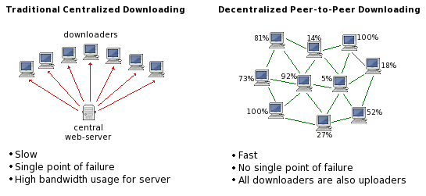
HOW DOES TORRENTING WORK
Torrent is a communication protocol that allows for data to be shared between users, without the data being uploaded to a central access point (or server) first.
Torrent allows for faster downloads than other HTTP or FTP.
Torrent itself is not illegal (it is just a communication protocol)

Slide 4
INTELLECTUAL PROPERTY LAWS
Intellectual property will usually have been copied, rather than being physically removed from an organisation’s servers
Intellectual property laws can have negative consequences, valuable resources such as textbooks and medicine are also classified as intellectual property.
The lack of affordable access to school textbooks presents a challenge for developing countries.

Slide 5
PIRACY IS STILL ALIVE AND WELL TODAY
There was a hope that streaming services would temper the use of piracy, but for the first time since the introduction of streaming, piracy is on the rise again.
https://www.pandasecurity.com/en/mediacenter/online-piracy-back/

